Slide 1
Portfolio Website

Slide 2

Loknete Hanmantrao Patil charitable Trust, Vita Adarsh Institute of Technology & Research centre, Vita dept. of Computer Science and Engineering
Roll No : CS2026 Class : CSE SY(B.TECH) Domain Name : HTML and CSS Seminar Title : Personal Portfolio Website Student Name : Vighnesh Mashnu Pawar
Guide Name : Prof. S. R.Mali

Slide 3
Table of content:
1. Introduction
2. Proposed System
3. Block Diagram
4. Advantages
5. Disadvantages
6. Conclusion
7. Reference
8. Thank you

Slide 4
Introduction:
This project aims at building a Personal Portfolio website which provides my own information .This website gives all my professional and some personal information . This website is used to solve the problem that arrives while gathering the personal information and services .
This project comprises of three files.
First is an HTML file for creating markup of the application .
Then CSS file is used to more styles to the website.
Then JS file is used to give proper functionality to the application through JavaScript.

Slide 5
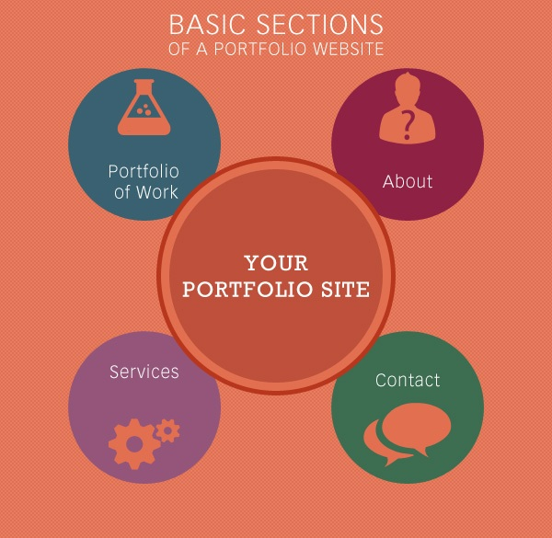
Proposed System :
It Contains Following Sections -
Home Page
About Section
Educational Details
My Skills Section
Project Sections
Contact section

Slide 6
Block Diagram :
My Skills
About
Page
Your Portfolio
Website
Projects
Section
Home
Page
Contact

Slide 7
Software tools:
VS Code
Xampp
Google Chrome

Slide 8
Advantages :
Gives you a chance to show off your creativity and personality
Shows that you’re a professional, which means employers and clients are more likely to trust you and your work
Creates Documentation to submit to reliable audiences or reviewers
Additionally, the portfolio is a great way to demonstrate your personality and extracurricular interests and to showcase your creative side.
To get easily access of work and contact information.

Slide 9
Disadvantages :
You have to maintain it.
You have to pay fees .
There might be security breaches to consider (you don’t want your site to be hacked after all),
Making big changes to the site might be more complicated than you think.
A professional portfolio requires constant updating to include the most current projects

Slide 10
Conclusion :
Make your portfolio site an opportunity to impress them by applying elements above and maintaining them with regular updates.
A portfolio website is a one-of-a-kind way to display your work and introduce yourself to others. It functions as an everlasting platform for your projects, research studies, and biographical information.
A portfolio website is an efficient and simple tool to collect all the best works you made as a professional and put it in one place to show everyone.
Creating your own portfolio website may become like building your own workshop .

Slide 11

Refernces :
Benefits of Portfolio Website :
https://www.researchgate.net/publication/272451538_The_benefits_and_development_of_a_personal_portfolio
2.

Slide 12
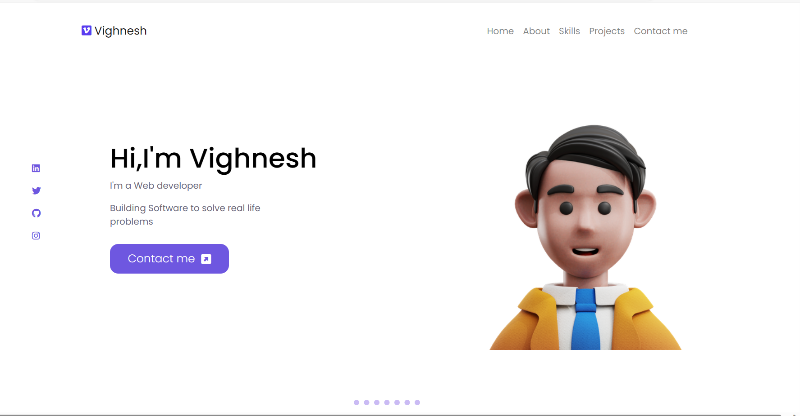
SnapShots:

Slide 13
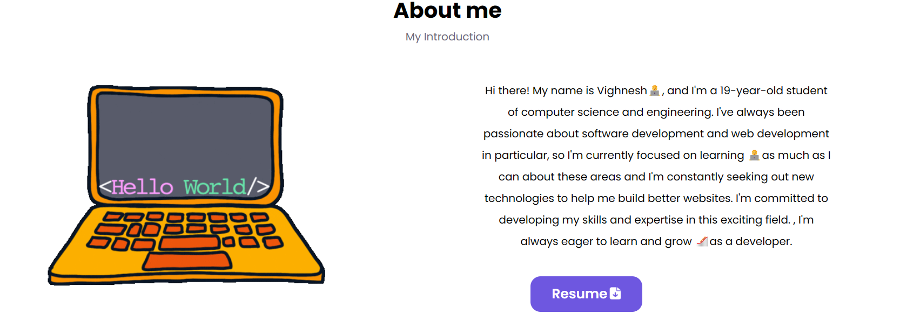

Slide 14
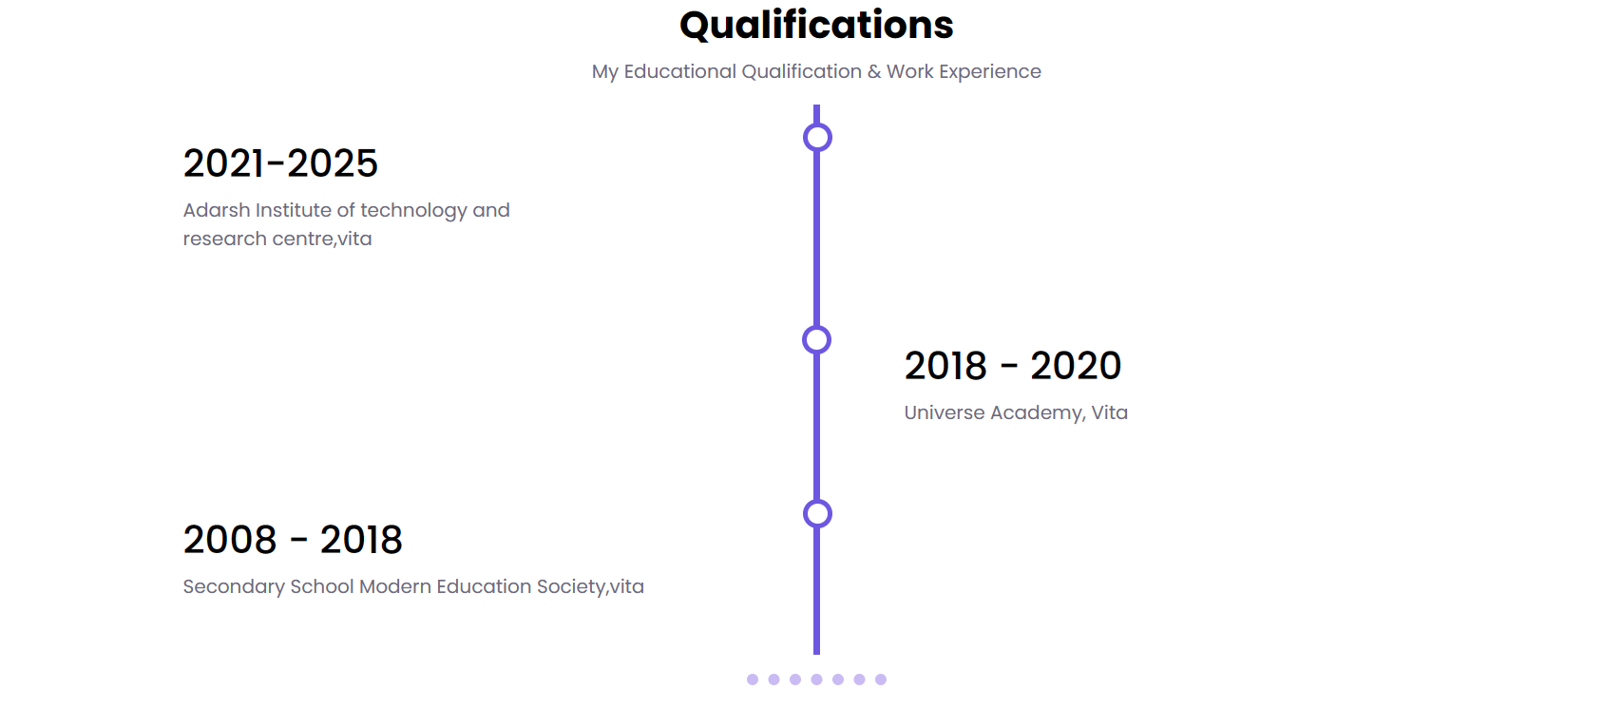

Slide 15
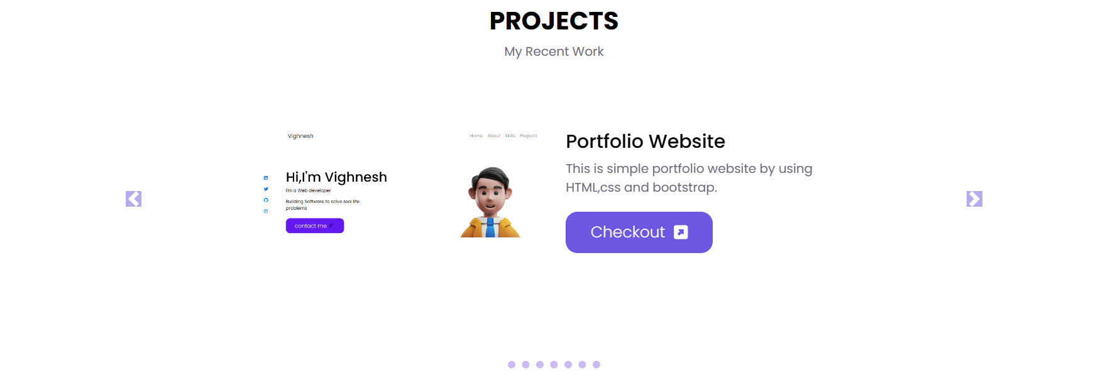

Slide 16
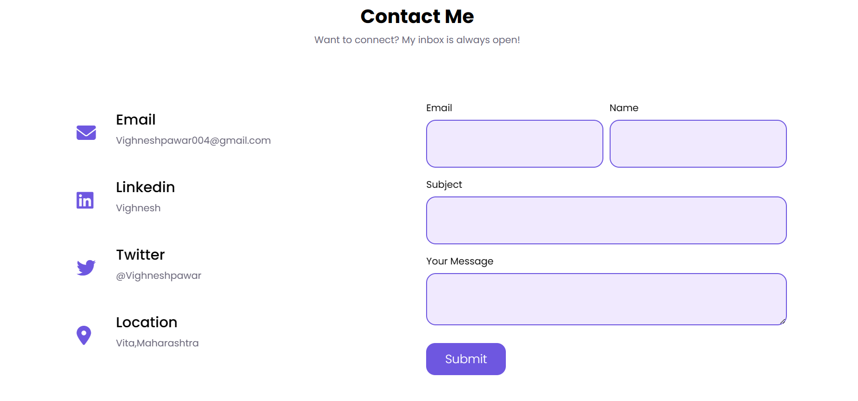

Slide 17


